Slide 1
Drug-Disease Relation Extraction with BERT(s)
Chetan Munugala, Kevin Lu, Spencer Song,

Slide 2
Biomedical Relation Extraction
Typically, the complexity of vocabulary, as well as the high variance in sentence structure in biomedical text has led to poor model performance.
Utilize massive, free, online databases
Focused on Drug-Disease Relations as it is the least studied area within biomedical relation extraction

Slide 3
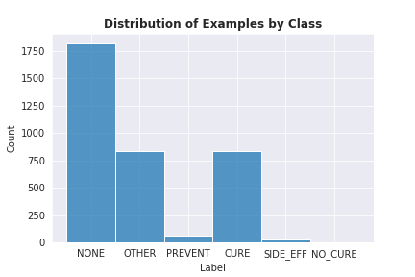
Data and Problem Setup
Used a labeled MEDLINE 2001 dataset, a drug-treatment classification dataset annotated by a domain expert
Multi-Class Classification
Class Imbalances

Slide 4
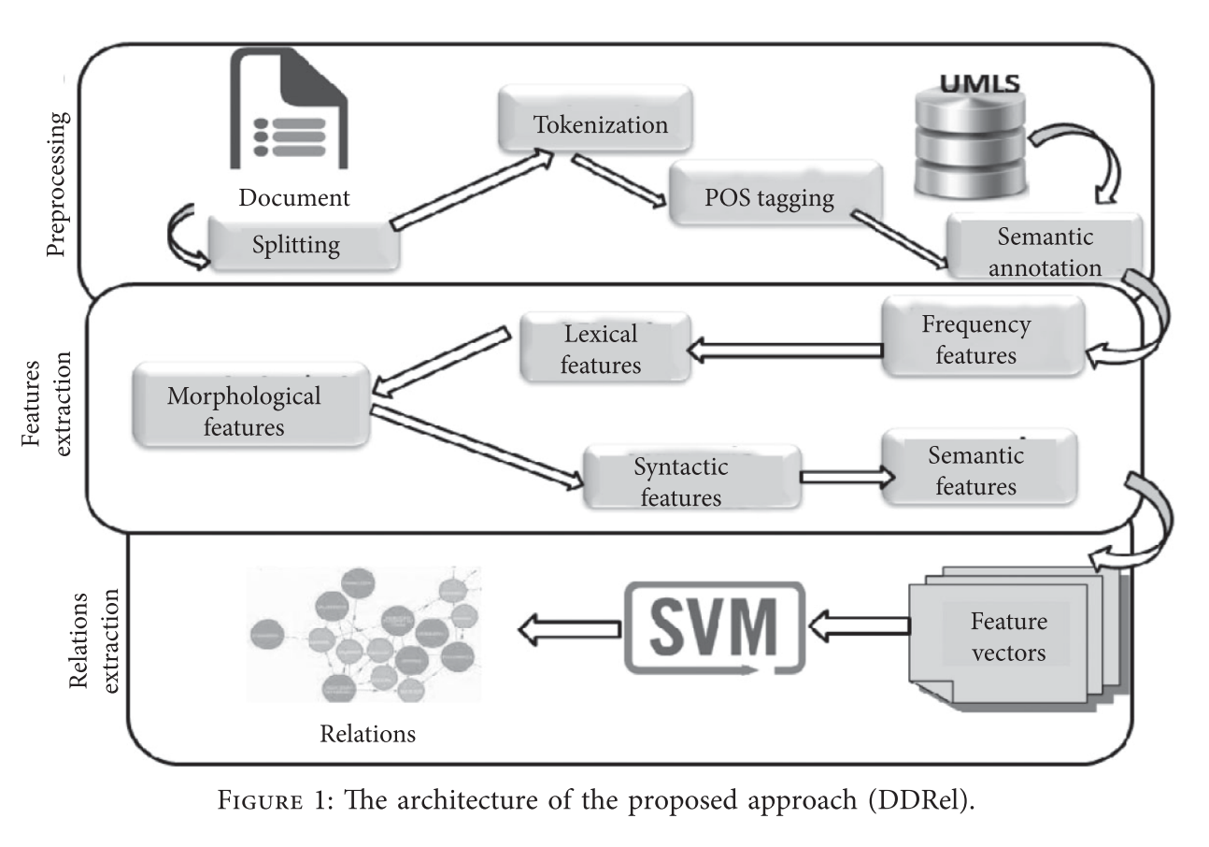
Previous Work

Slide 5
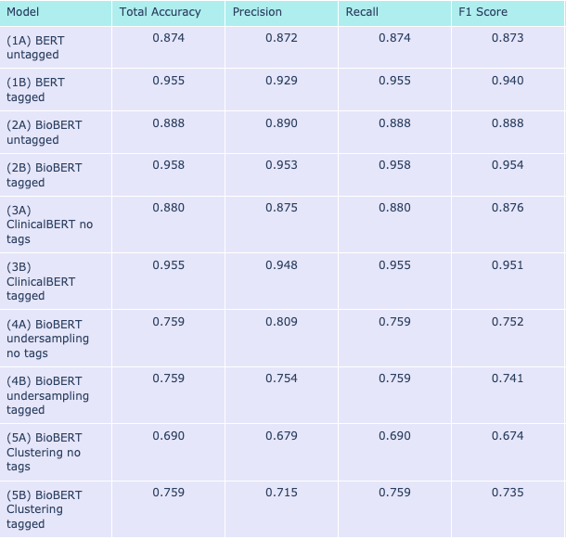
Our Approach
• Implemented BERT, BIOBERT, ClinicalBERT
• Undersampled and Clustered to deal with class imbalances

Slide 6
Conclusions
• Did not achieve comparable F-scores to DDrel approach
• Used far fewer preprocessing steps
• Makes the problem more approachable/shows utility of pre-trained transformers models

